Slide 1

Light-Based Secure File Transfer System
Team Members: Samyak Gandhi (22BCP082), Tiyarsna Solanki (22BCP066)
Under Guidance of: Ms. Ashka Raval
Department of Computer Engineering

Slide 2
The Challenge
Security Risks
Restricted Access
Data Breaches
Digital data exchange poses threats in sensitive environments
USB, Wi-Fi, Bluetooth banned in high-security zones
Espionage and evidence tampering risks

Slide 3

Our Solution
Covert LED Communication
Offline file transfer using optical channel
No Wi-Fi dependency
No Bluetooth required
No USB connections
Trace-less transmission

Slide 4

Key Applications
Military Bases
Forensic Labs
Research Centres
Secure communication in air-gapped defence environments
Evidence transfer without contamination or tampering risks
Confidential data exchange in isolated research facilities

Slide 5





How It Works
Binary Conversion
File converted to binary data
Manchester Encoding
Data encoded for synchronisation
LED Transmission
Light pulses transmit signal
LDR Detection
Receiver captures variations
File Reconstruction
Binary decoded to file

Slide 6

Why Manchester Encoding?
Simple OOK Pulsing
Manchester Encoding
Sensitive to intensity & noise
Works in noisy environments
Hard to distinguish 0 & 1
Clear 0 & 1 differentiation
Synchronisation issues
Self-synchronising signal
Higher bit error probability
Lower transmission errors

Slide 7
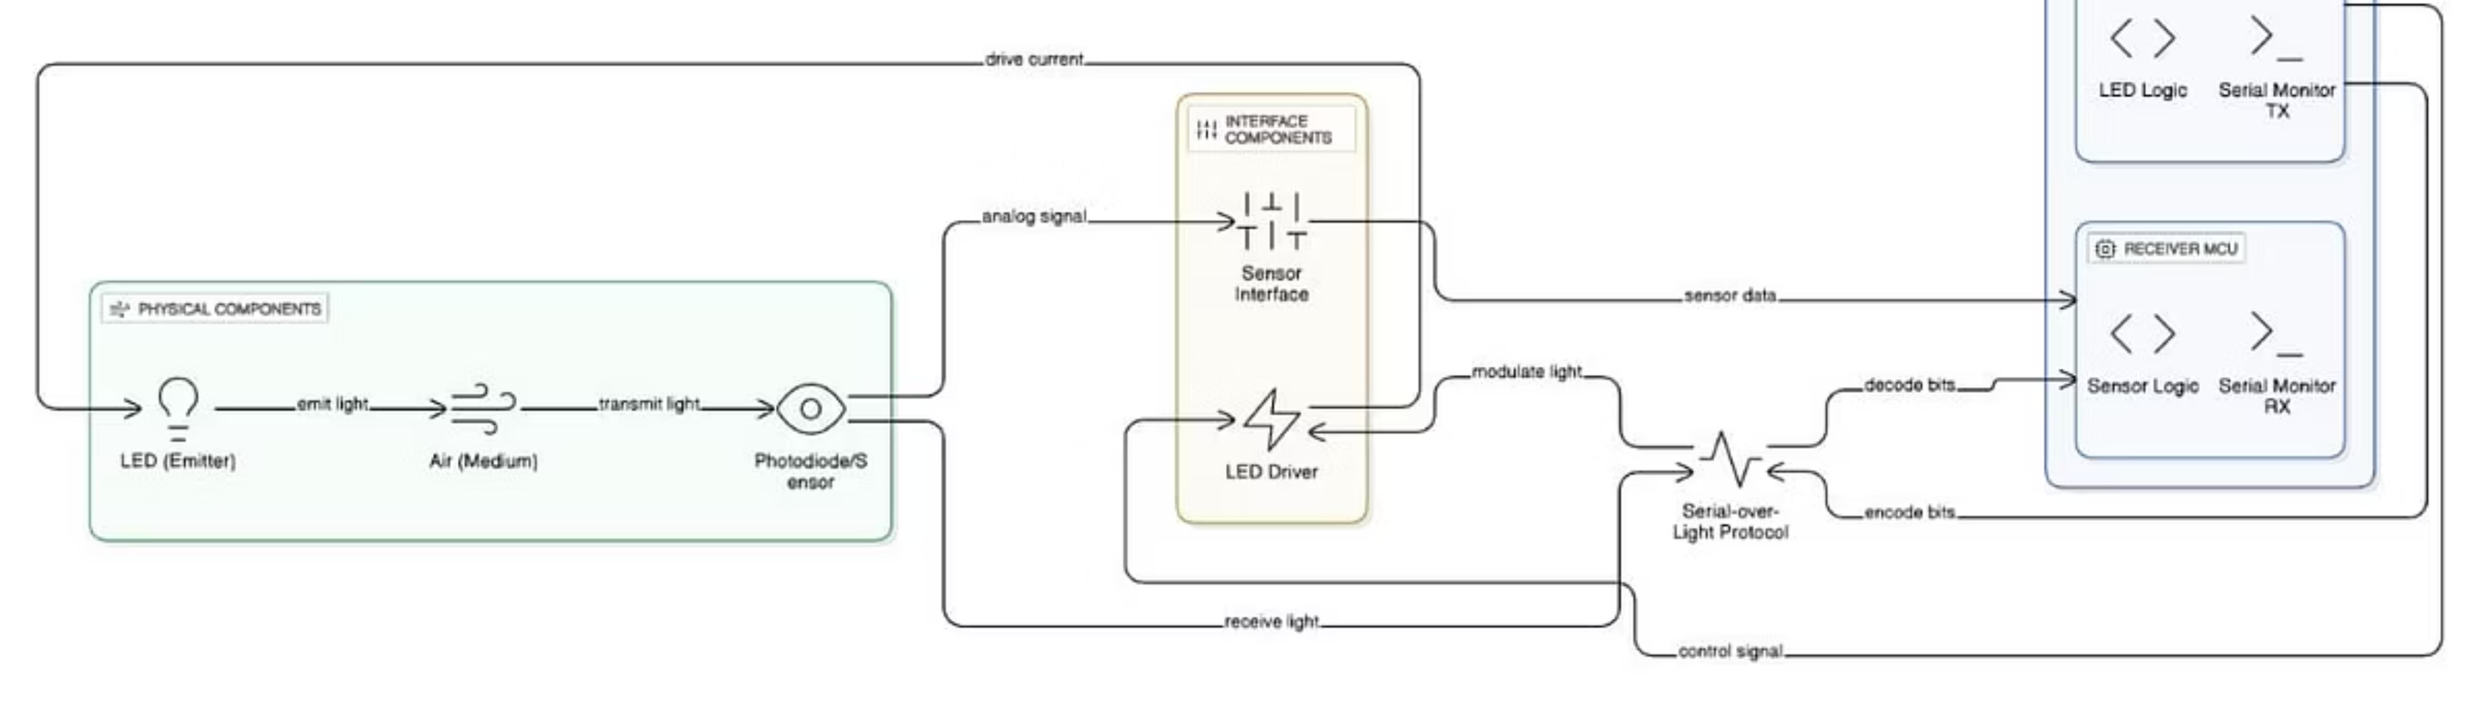
System Architecture
Transmitter
Receiver
Error Protection
Arduino Nano + High-brightness LED
LDR + Op-Amp + Microcontroller
CRC/checksum verification

Slide 8
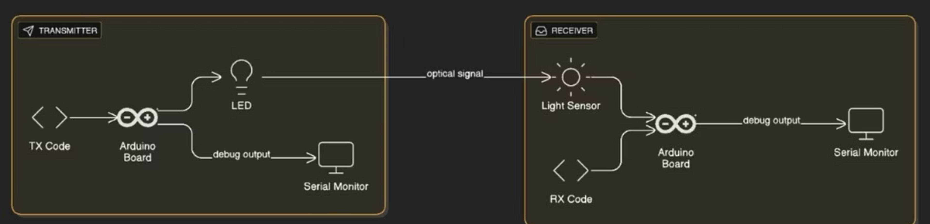
Technical Components
01
02
LED Control
Light Detection
Digital PWM pin controls LED intensity
LDR senses intensity variations
03
04
Signal Amplification
Binary Conversion
LM358 Op-Amp converts analogue response
Microcontroller converts voltage to bits

Slide 9

Experimental Results
1-2m
Low
Transmission Range
Bit Error Rate
Stable indoor communication distance
Manchester encoding ensures accuracy
Performance Factors
LED brightness levels
Ambient light conditions
Distance between devices
Noise reduction techniques
Watch demonstration: https://docs.google.com/videos/d/18DjlHtdivheL-Mq4qNrJ0a2_oUj4Y41KF22Ju8IuWzc/play

Slide 10
Future Enhancements
Laser & Photodiode
Higher speed and longer range transmission
AES-128 Encryption
Enhanced security layer for data protection
Bi-directional Communication
Full-duplex data exchange capability
ML Noise Filtering
Machine learning for improved accuracy
Mobile Interface
User-friendly app for easy operation

Slide 11

Conclusion
Secure & Covert Transfer
Overcomes Restrictions
Our system offers a low-cost, secure, and untraceable method for file transfer.
Effectively operates in high-security zones where traditional networking is prohibited.
Versatile Applications
Viable LED Communication
Proves highly beneficial across forensics, defence, and research facilities.
Successfully demonstrates the effectiveness of LED-based optical communication for data transfer.
Thank You!

